Slide 1


Stakeholder Feedback Evaluation Tool

Slide 2


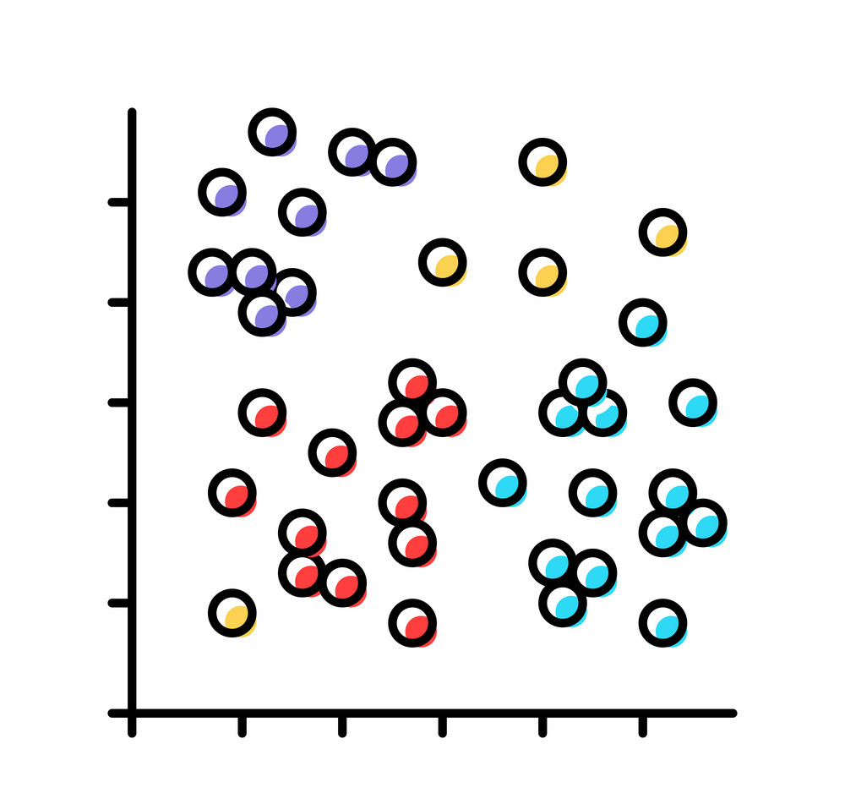



Tool Overview
Conversational Chatbot
Stakeholder
Resident
Staff
Contractor
Database
Store feedback in secure dataset
Theme & Sentiment Extraction
LLM automatically extract themes and assigns sentiment towards themes
Theme clustering
Groups similar themes and re-applies to stakeholder
Instructions
i.e. what information are we seeking?

Slide 3

Conversational Feedback Chatbot
Initial set of ‘target’ questions (to be played around with)
How have you felt regrarding the communication you have received from the council, as well as the contractors?
How do you feel about the contractors that have been working on your home? Have they been respectful and professional?
How do you feel about the work that has been done on your home? Are you happy with the results?
How do you feel about the impact that the work has had on your home? Has it been disruptive or inconvenient?
Are you happy with the way that the work has been carried out? Have there been any issues or problems that you have encountered?
How do you feel about the way that the work has been communicated to you? Have you been kept informed about what is happening and when?
How do you feel about the way that the work has been managed? Have there been any delays or issues that you have encountered?
Are you confident that the work will resolve the issues that you have been experiencing in your home?
Do you think that the work will lead to a reduction in your energy bills?
Demo

Slide 4
Evaluation Tool Overview
Feedback Analyser
Stakeholder
Resident
Staff
Contractor
Database
Store feedback in secure dataset
Theme & Sentiment Extraction
LLM automatically extract themes and assigns sentiment towards themes
Theme clustering
Groups similar themes and re-applies to stakeholder
Instructions
i.e. what information are we seeking?

Slide 5

Feedback Analyser: Step 1
[{'theme': 'Worker Conduct', 'sentiment': 5},
{'theme': 'Project Efficiency', 'sentiment': 5}, {
'theme': 'Scheduling and Planning', 'sentiment': 2},
{'theme': 'Disruption', 'sentiment': 2}]
“There was no proper explanation of what work would be done. I only found out about scaffolding going up the day it happened. Poor planning from the council.”
“Extract relevant themes and corresponding sentiment scores. (1 very negative – 5 very positive”)
“The workers were in and out quickly, and they were very polite. But I did have to take a few days off work unexpectedly, which I wasn't happy about.”
{'theme': 'Overall Improvement', 'sentiment': 4},
{'theme': 'Workmanship Quality (Painting)', 'sentiment': 2}
.
.
.
.
.
.
“……”
“……”

Slide 6
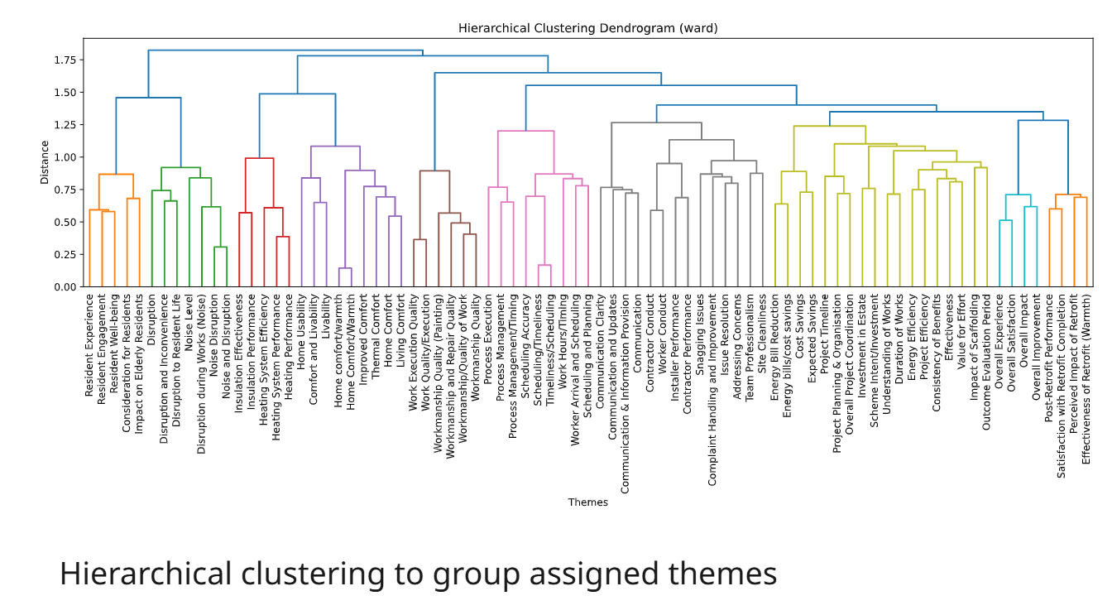
Feedback Analyser: Step 2
{'theme': 'Communication & Information Provision', 'sentiment': 1},
{'theme': 'Project Planning & Organisation', 'sentiment': 1}
Clustering Algorithm
{'theme': 'Overall Improvement', 'sentiment': 4},
{'theme': 'Workmanship Quality (Painting)', 'sentiment': 2}
.
.
.
“……”

Slide 7
Feedback Analyser: Step 3
{'theme': 'Communication & Information Provision', 'sentiment': 1},
{'theme': 'Project Planning & Organisation', 'sentiment': 1}
{'theme': 'Communication & Information Provision', 'sentiment': 1},
{'theme': 'Project Planning & Organisation', 'sentiment': 1}
“For themes in the provided cluster, find a theme name that best captures all of them”
[{'theme': 'Worker Conduct', 'sentiment': 5},
{'theme': 'Project Efficiency', 'sentiment': 5}, {
'theme': 'Scheduling and Planning', 'sentiment': 2},
{'theme': 'Disruption', 'sentiment': 2}]
{'theme': 'Overall Improvement', 'sentiment': 4},
{'theme': 'Workmanship Quality (Painting)', 'sentiment': 2}
Mapping
.
“……”
{'final_theme': 'Service Quality and Customer Care', 'sentiment': 1}
{'final_theme': 'Project Management and Outcomes', 'sentiment': 1}]
[{'final_theme': 'Service Quality and Customer Care', 'sentiment': 5},
{'final_theme': 'Project Management and Outcomes', 'sentiment': 5},
{'final_theme': 'Operational Scheduling and Timing', 'sentiment': 2},
{'final_theme': 'Noise Disruption', 'sentiment': 2}]
.
“……”

